Slide 1

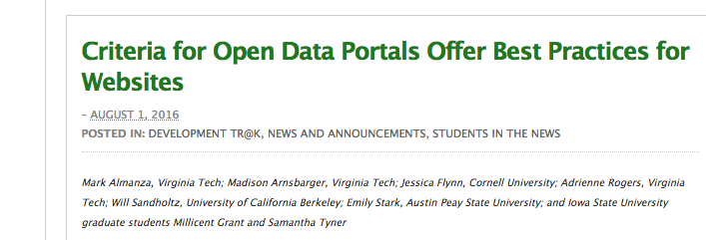

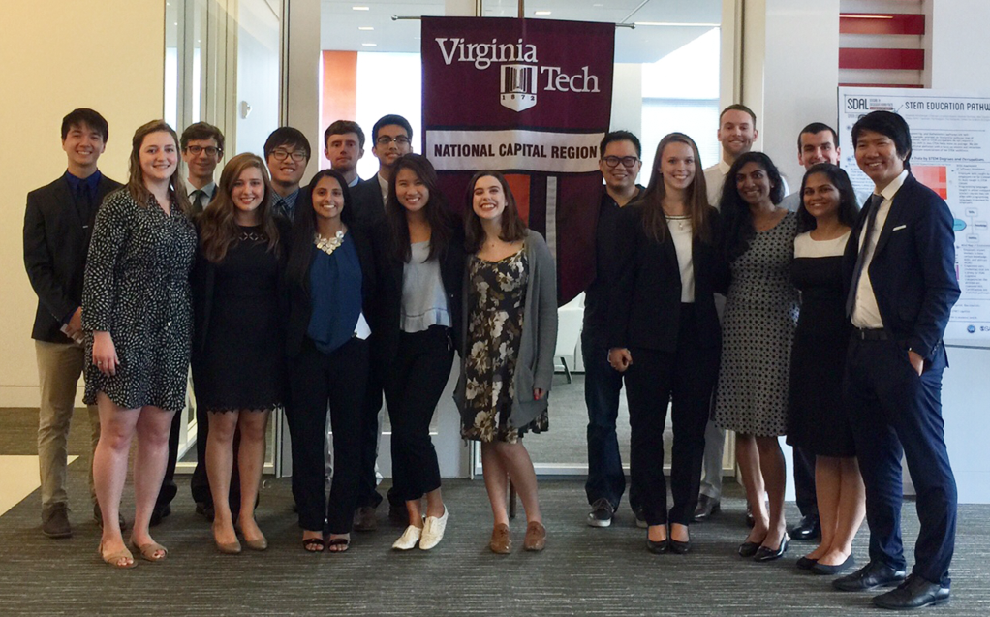
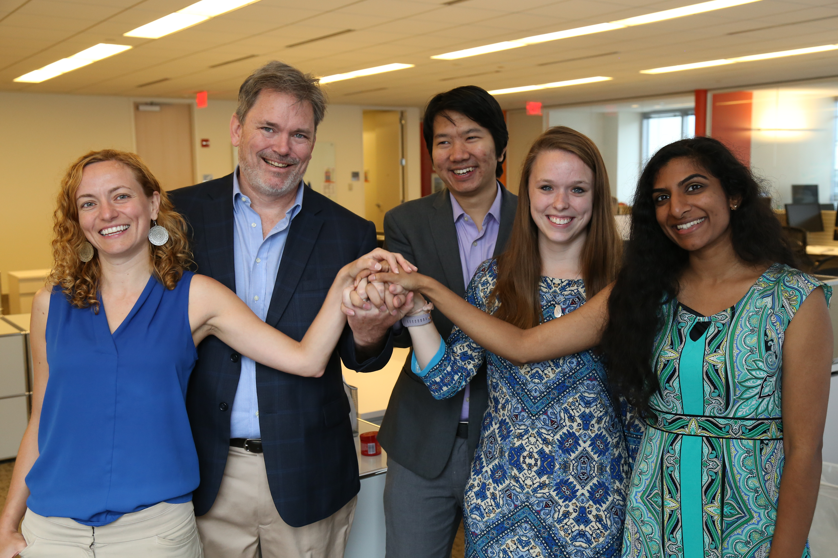

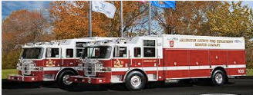




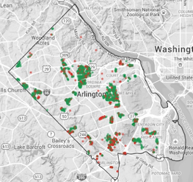
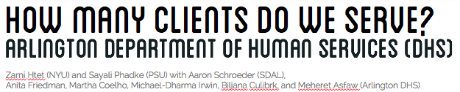
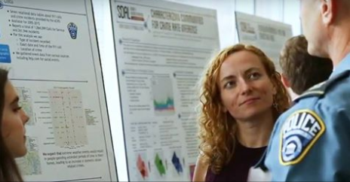






Data Science for the Public Good (DSPG)
by Biocomplexity Institute of Virginia Tech
Directors: Gizem Korkmaz and Aaron Schroeder, Social and Decision Analytics Laboratory
Outreach: Dr. Shernita Lee, Education and Outreach
The Data Science for the Public Good (DSPG) program equips new generations of scientists with the skills they need to inform intelligent governmental policy and decision-making. DSPG is delivered by the Social and Decision Analytics Laboratory (SDAL), a leading laboratory in the Biocomplexity Institute of Virginia Tech, located at Virginia Tech Research Center in Arlington, VA. SDAL combines expertise in statistics and social & behavioral sciences to develop quantitative methods and evidence-based research to inform decision-making and evaluation.
Every summer, SDAL researchers and DSPG students team up to work on projects that focus on the interface of data analytics and social science to address real problems at the local, state, and federal levels.
•Horizontally and vertically integrated team research (multidisciplinary) with dedicated graduate students, postdocs and faculty
•In collaboration with sponsors from local, state and federal governments
•Professional training through development workshops and seminars
•Expert training in essential tools for statistical computing, including Hadoop, R, Python, and GIS.
•Opportunity to interact with decision-makers in industry and government agencies and attend
policy events on Capital Hill and the surrounding area.
•Technical report and publication opportunities THESE BULLETS ARE OFF WRT FORMATTING
DSPG Fellows
DSPG Undergraduate Students
Selected through a competitive national search
Possess high quantitative, statistical, computational and programming skills
Lead, support and guide the VT undergraduate students
The program is open to all VT undergraduate students through the Honors college.
Requirement is to enroll in the following courses during the Summer I and Summer II semesters:
Summer I
UH 4504: Honors Discovery and Innovation Studio (3 credits)
UH 4994: Honors Undergraduate Research (3 credits)
Summer II
UH 4504: Honors Discovery and Innovation Studio (3 credits)
UH 4994: Honors Undergraduate Research (3 credits)
A Wide Range of Projects
DSPG Symposium
Thanks to Our Sponsors
ADD SOME PHOTO OF YOU AND AARON
Local / State Government
Arlington County Fire & Police Departments
Fairfax Counties
Virginia Department of Health
Virginia Department of Emergency Management
Federal Statistical Agencies
Housing and Urban Development
National Center for Science and Engineering Statistics
National Science Foundation
U.S. Census Bureau
Department of Defense
U.S. Army Research Institute
Defense Advanced Research Project Agency
The Minerva Research Initiative
Industry
MITRE Corporation
Proctor & Gamble
Foundations
Robert Wood Johnson
Laura and John Arnold

